Slide 1
Course code : CSE3009 Course title : No SQL Data Bases Module : 1 Topic : 1
Introduction to NoSQL Concepts

Slide 2
Objectives
This session will give the knowledge about
Database revolutions
First generation Database
Second generation Database
Third generation Database
What is NoSQL?
Comparison between SQL and NoSQL?

Slide 3
What is Database?
A database is a collection of data, typically describing the activities of one or more related entities and attributes.
A database management system, or DBMS, is software designed to assist in maintaining and utilizing large collections of data, and the need for such systems, as well as their use, is growing rapidly.

Slide 4
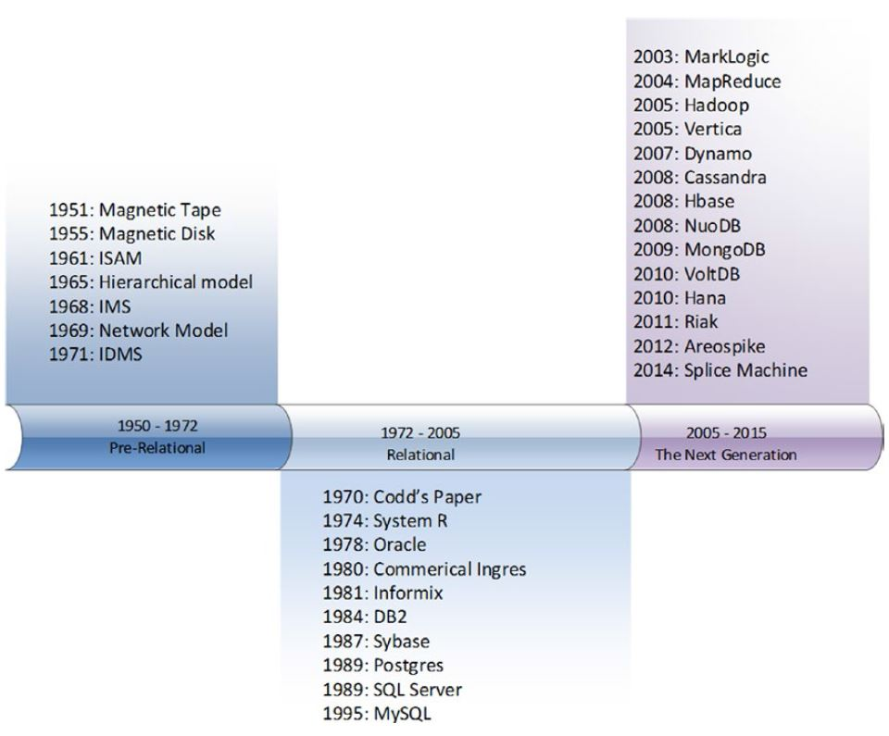
Evolution of Database

Slide 5
First Database Revolution
The emergence of electronic computers following the Second World War represented the first revolution in databases.
Early “databases” used paper tape initially and eventually magnetic tape to store data sequentially.
1955: spinning magnetic disk - direct high-speed access to individual records
1961: ISAM (Index Sequential Access Method) made fast record-oriented access feasible and consequently leads to OLTP (On-line Transaction Processing) computer systems.

Slide 6
First Database Revolution
By the early 1970s, two major models of DBMS were competing for dominance.
The network model was formalized by the CODASYL standard and implemented in databases such as IDMS.
The hierarchical model provided a somewhat simpler approach found in IBM’s IMS (Information Management System).

Slide 7
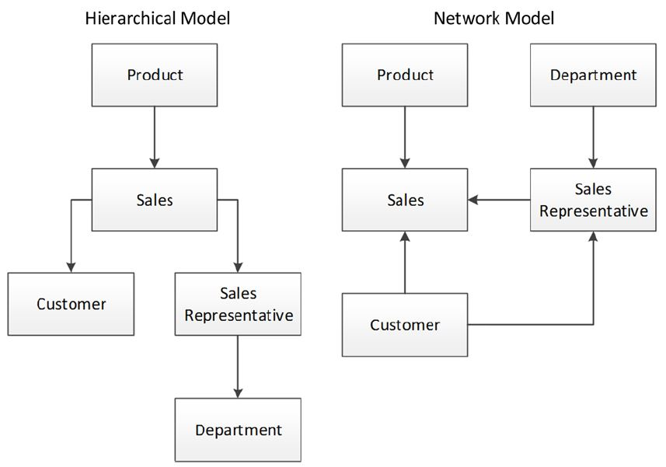
Hierarchical vs Network model

Slide 8
Second Database Revolution
In the late 1960s, Codd who is working at an IBM laboratory, found the following drawbacks in First generation DBMS:
Existing databases were too hard to use.
Existing databases lacked a theoretical foundation.
Existing databases mixed logical and physical implementations.
To overcome all these, he published a core ideas that defined the relational database model that became the most significant model for database systems for a generation

Slide 9
New in Second generation
Key concepts of the relational model include:
Attributes
Tuples
Relation
Constraints
Operations
Normal forms

Slide 10
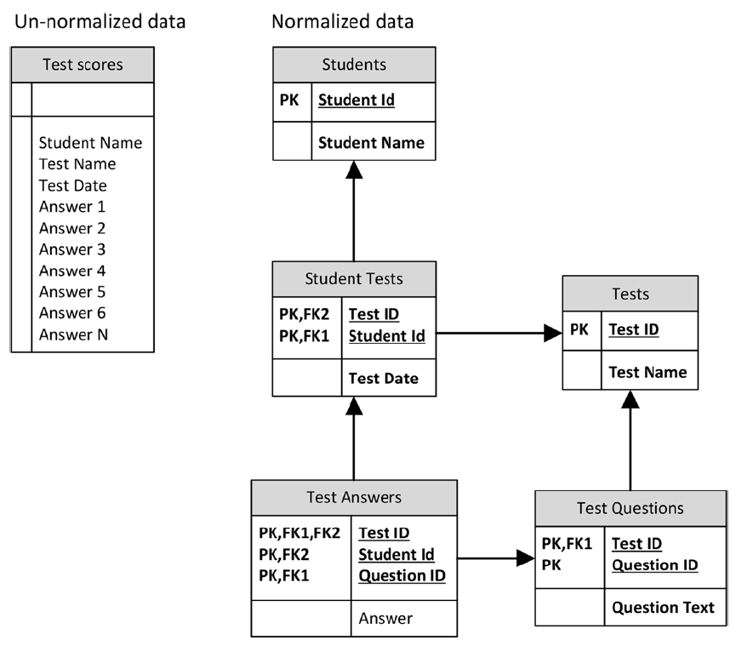
Benefits in Second generation

Slide 11
Transaction Models
Jim Gray defined the most widely accepted transaction model in the late 1970s. This soon became popularized as ACID transactions
Atomic: The transaction is indivisible - either all the statements in the transaction are applied to the database or none are.
Consistent: The database remains in a consistent state before and after transaction execution.
Isolated: While multiple transactions can be executed by one or more users simultaneously, one transaction should not see the effects of other in-progress transactions.
Durable: Once a transaction is saved to the database, its changes are expected to persist even if there is a failure of operating system or hardware.

Slide 12
SQL
In 1970, Edgar Codd, at IBM's San Jose Research Laboratory, proposed a new data representation framework called the relational data model.
In the 1980s,The SQL query language for relational databases, developed as part of IBM's System R project, is now the standard query language.
SQL was standardized in the late 1980s, and the current standard, SQL-92, was adopted by the American National Standards Institute (ANSI) and International Standards Organization (ISO).
During the succeeding decades many new database systems were introduced. These include Sybase, Microsoft SQL Server, Informix, MySQL, and DB2.

Slide 13
Third Database Revolution
By 2005, Google was by far the biggest website in the world.
When Google began, the relational database was already well established, but it was inadequate to deal with the volumes and velocity of the data confronting Google.
In 2003, Google revealed details of the distributed file system GFS
In 2004 it revealed details of the distributed parallel processing algorithm “MapReduce”
In 2006, Google revealed details about its BigTable distributed structured database.

Slide 14
Drawbacks in Second Database Revolution
Even the most expensive commercial RDBMS such as Oracle could not provide sufficient scalability to meet the demands of large web sites.
To overcome this major issue, distributed databases has been introduced.
“Sharding” involves partitioning the data across multiple databases based on a key attribute, such as the customer identifier.
Sharding at sites like Facebook has allowed a MySQL-based system to scale up to massive levels, but the downsides of doing this are immense. Many relational operations and database-level ACID transactions are lost.

Slide 15
Cloud Computing
Between 2006 and 2008, Amazon rolled out Elastic Compute Cloud (EC2).
EC2 made available virtual machine images hosted on Amazon’s hardware infrastructure and accessible via the Internet.
Amazon added other services such as storage (S3, EBS), Virtual Private Cloud (VPC), a MapReduce service (EMR), and so on.
The entire platform was known as Amazon Web Services (AWS) and was the first practical implementation of an Infrastructure as a Service (IaaS) cloud.
AWS became the inspiration for cloud computing offerings from Google, Microsoft, and others.

Slide 16
Document Databases
The impedance mismatch between object-oriented and relational models, leads to Object relational mapping systems.
This was enabled by the programming style known as AJAX (Asynchronous JavaScript and XML), in which JavaScript within the browser communicates directly with a backend by transferring XML messages.
XML was soon superseded by JavaScript Object Notation (JSON), which is a self-describing format similar to XML but is more compact and tightly integrated into the JavaScript language.
The databases which supports JSON to directly create and access the database and eliminates the role of relational middle man is known as “Document Databases”.
CouchBase and MongoDB are two popular JSON-oriented databases, though virtually all nonrelational databases

Slide 17
NewSQL
In 2007, Michael Stonebraker and his team proposed a number of variants on the existing RDBMS design.
H-Store described a pure in-memory distributed database
C-Store specified a design for a columnar database.
Both these designs were extremely influential in the years to come and are the first examples of what came to be known as NewSQL database systems
NewSQL databases that retain key characteristics of the RDBMS but that diverge from the common architecture exhibited by traditional systems such as Oracle and SQL Server.

Slide 18
The Nonrelational Explosion
At the conclusion, dozens of new database systems like such as MongoDB, Cassandra, and HBase emerged due to the drawbacks of relational databases.
These new breeds of database systems lacked a common name “Distributed Non-Relational Database Management System” (DNRDBMS).
However, in late 2009, the term NoSQL quickly caught on as shorthand for any database system that broke with the traditional SQL database.

Slide 19
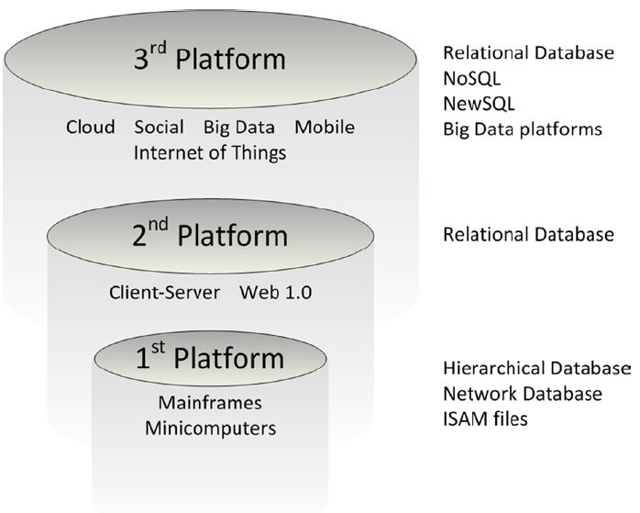
The Database technologies

Slide 20
What is NoSQL?
NoSQL database, also called Not Only SQL, is an approach to data management and database design that's useful for very large sets of distributed data.
NoSQL is not a relational database
A relational database model may not be the best solution for all situations.
The easiest way to understand NoSQL, is that of a database which does not adhering to the traditional relational database management system (RDMS) structure.

Slide 21
What is NoSQL?
The most popular NoSQL database is Apache Cassandra.
Cassandra, which was once Facebook’s proprietary database, was released as open source in 2008.
Other NoSQL implementations include SimpleDB, Google BigTable, Apache Hadoop, MapReduce, MemcacheDB, and Voldemort.
Companies that use NoSQL include NetFlix, LinkedIn and Twitter.

Slide 22
Why we should use NoSQL?
There are several reasons why people consider using a NoSQL database.
Application development productivity.
Large data.
Analytics.
Scalability.
Massive write performance.
Fast key-value access.
Flexible data model and flexible datatypes.
Schema migration.
Write availability.
Easier maintainability, administration and operations.
Generally available parallel computing.
Programmer ease of use.
Distributed systems and cloud computing support.

Slide 23
SQL vs NoSQL
SQL | NoSQL
Relational Databases (RDBMS) | Non-relational or distributed database
Table based databases | Document based, key-value pairs, graph databases or wide-column stores
Have predefined schema | Have dynamic schema for unstructured data
Vertically scalable | Horizontally scalable
Uses SQL (structured query language) | Uses UnQL (Unstructured Query Language). The syntax of using UnQL varies from database to database

Slide 24
SQL vs NoSQL
SQL | NoSQL
MySql, Oracle, Sqlite, Postgres and MS-SQL | MongoDB, BigTable, Redis, RavenDb, Cassandra, Hbase, Neo4j and CouchDB
Good fit for the complex query | Not good fit for complex queries (NoSQL don’t have standard interfaces)
Not best fit for hierarchical data storage | Fits better for the hierarchical data storage
Scalability is managed by increasing the CPU, RAM, SSD, etc | Scalability is managed by adding few more servers easily in your NoSQL database
Best fit for heavy duty transactional type applications | Not fit for heavy transactional applications

Slide 25
SQL vs NoSQL
SQL | NoSQL
Excellent support are available for all SQL database | Still have to rely on community support
Emphasizes on ACID properties ( Atomicity, Consistency, Isolation and Durability) | Follows the Brewers CAP theorem ( Consistency, Availability and Partition tolerance )
Classified as either open-source or close-sourced | Classified on the basis of way of storing data as graph databases, key-value store databases, document store databases, column store database and XML databases.

Slide 26
NewSQL
NewSQL is a modern relational database system that bridges the gap between SQL and NoSQL.
NewSQL databases aim to scale and stay consistent.
NewSQL is a unique database system that combines ACID compliance with horizontal scaling.
The database system strives to keep the best of both worlds.
OLTP-based transactions and the high performance of NoSQL combine in a single solution.

Slide 27
NewSQL - Advantages
The main features of NewSQL databases are:
In-memory storage and data processing supply fast query results.
Partitioning scales the database into units.
Queries execute on many shards and combine into a single result.
ACID properties preserve the features of RDBMS.
Secondary indexing results in faster query processing and information retrieval.
High availability due to the database replication mechanism.

Slide 28
NewSQL: Comparision
Feature | SQL | NoSQL | NewSQL
Schema | Relational (table) | Schema-free | Both
SQL | Yes | Depends on the system | Yes, with enhanced features
ACID | Yes | No (BASE) | Yes
OLTP | Partial support | Not supported | Full support
Scaling | Vertical | Horizontal | Horizontal
Distributed | No | Yes | Yes
High availability | Custom | Auto | Built-in
Queries | Low complexity queries | High complexity queries | Both

Slide 29
NewSQL Examples
Some well known NewSQL Databases
Apache Trafodion.
Clustrix.
CockroachDB.
Couchbase.
Google Spanner.
NuoDB.
Pivotal GemFire XD.

Slide 30
Summary
This session will give the knowledge about
Database revolutions
First, Second and Third generation Database
What is NoSQL?
Comparison between SQL and NoSQL?
What is NewSQL?
Comparison between SQL, NoSQL and NewSQL?

